Slide 1
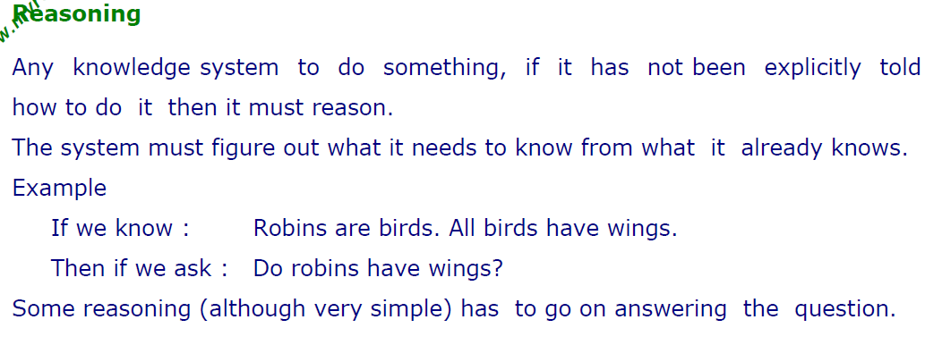

Slide 2
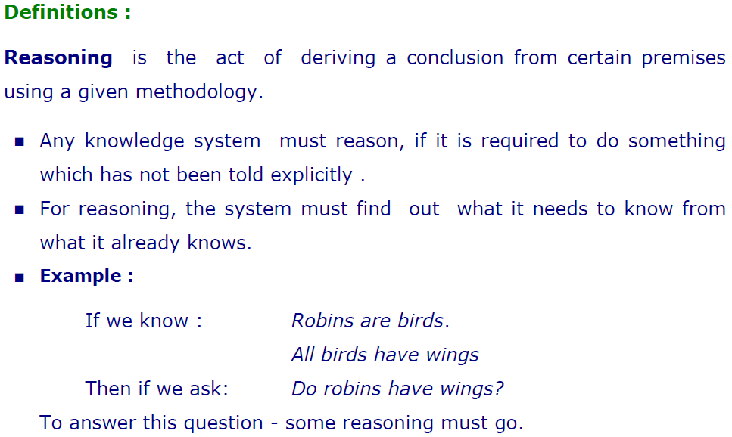

Slide 3
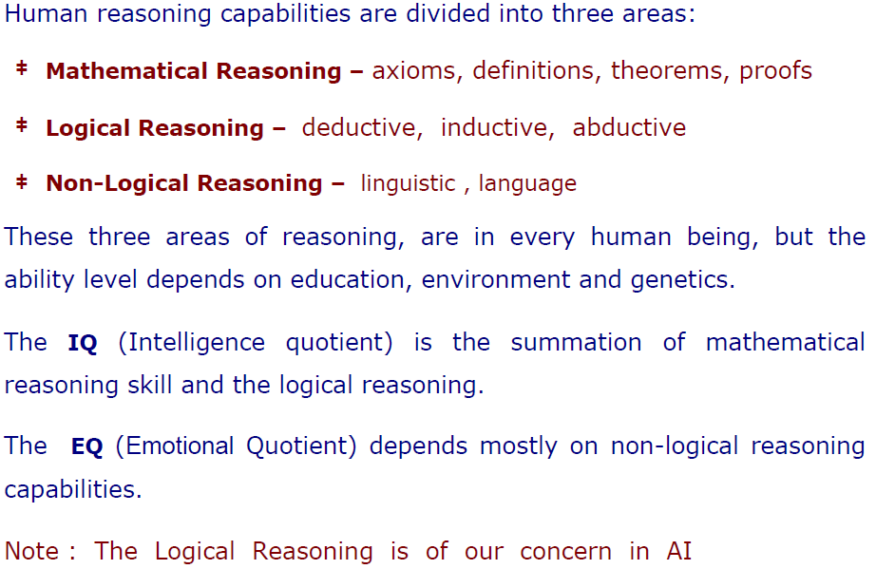

Slide 4
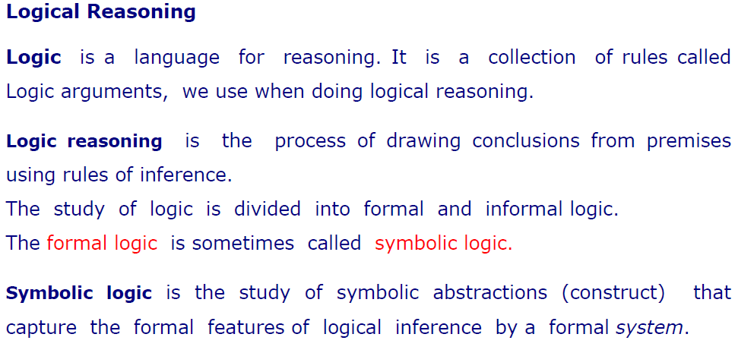

Slide 5
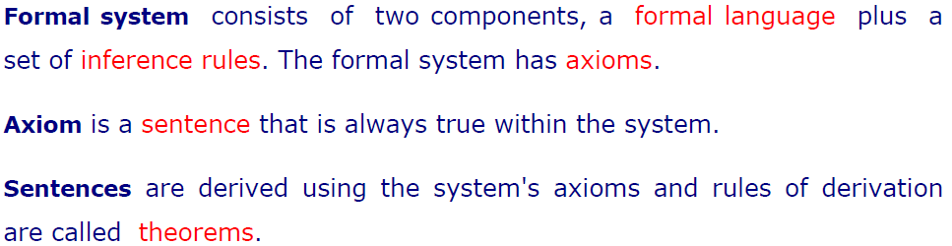

Slide 6
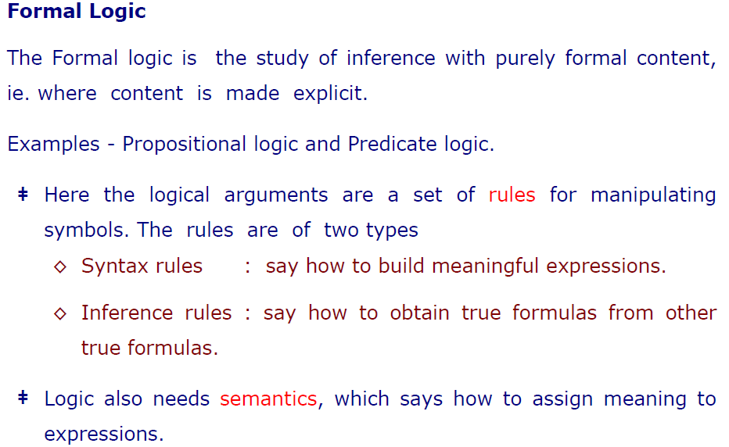

Slide 7
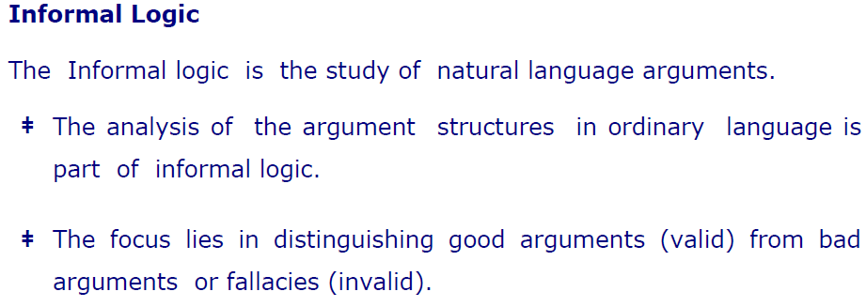

Slide 8
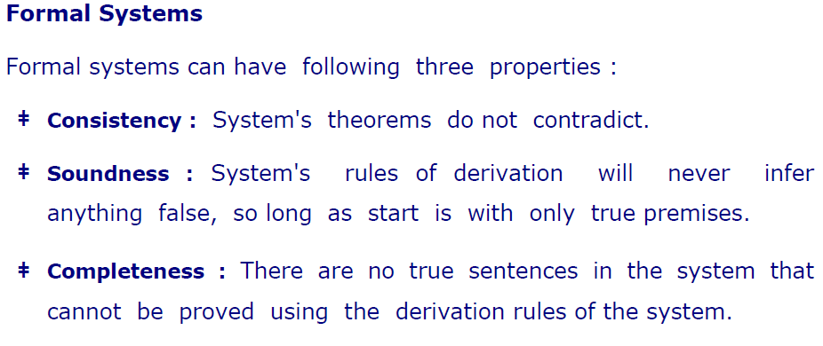

Slide 9
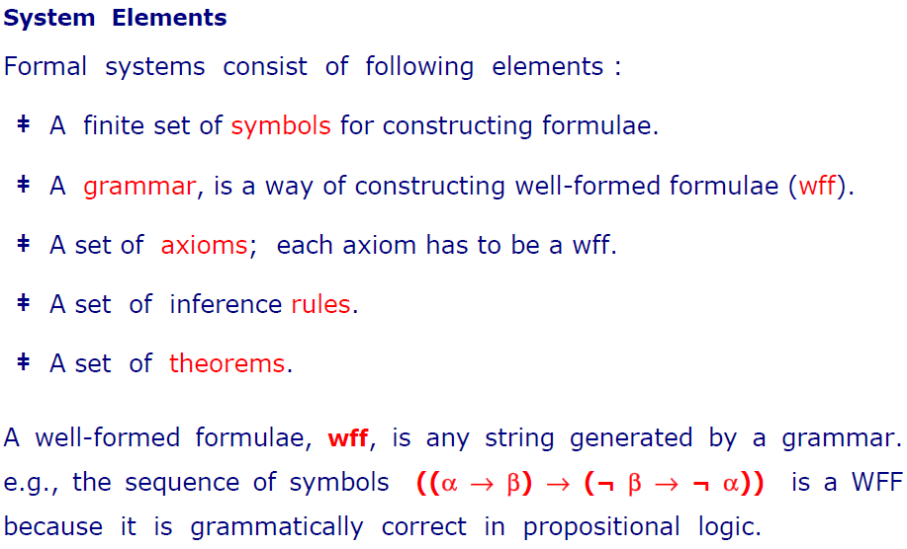

Slide 10
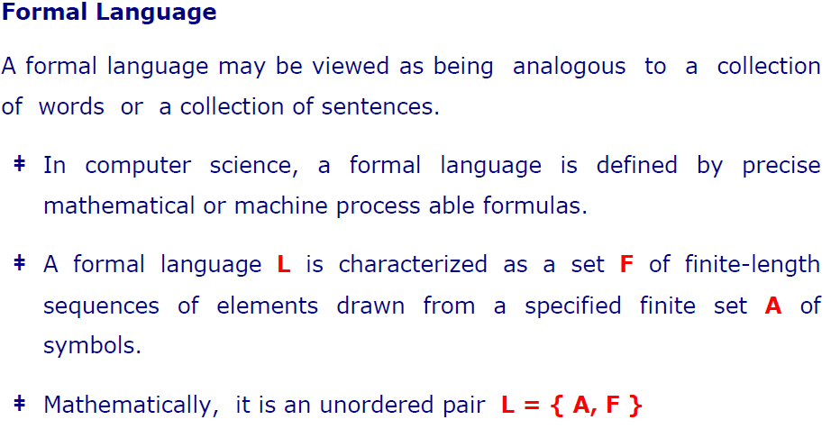

Slide 11
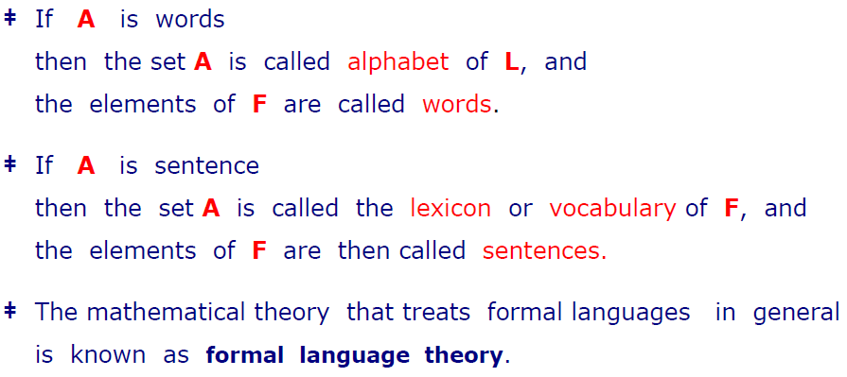

Slide 12
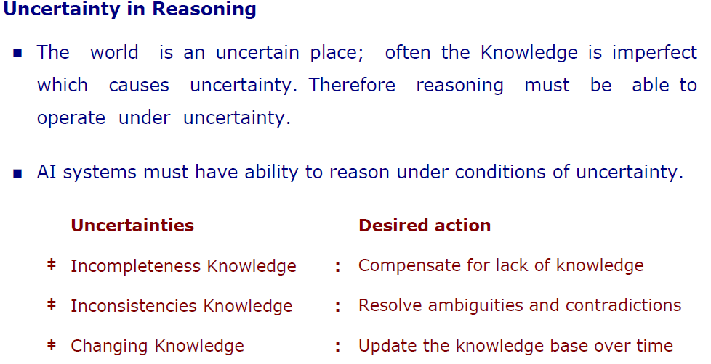

Slide 13


Slide 14
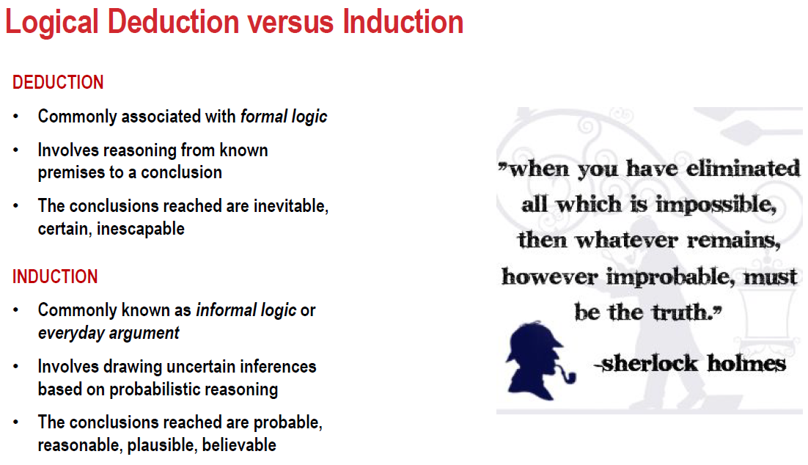

Slide 15
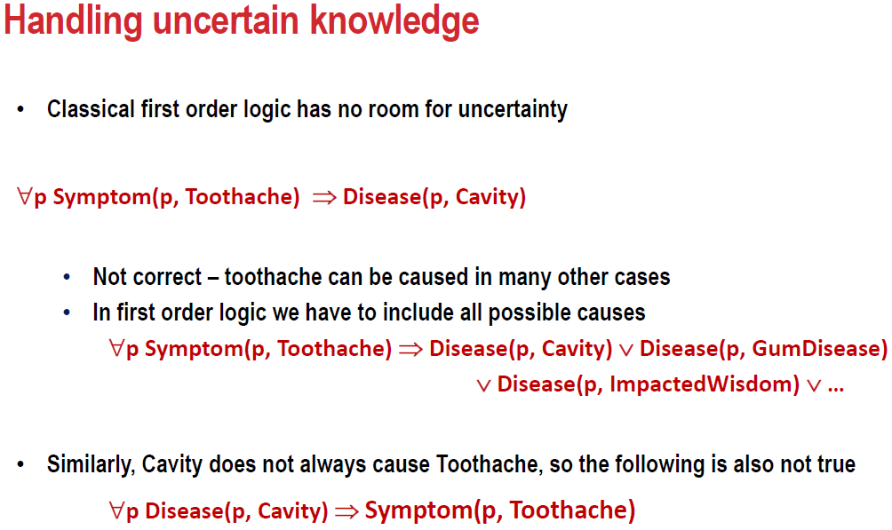

Slide 16
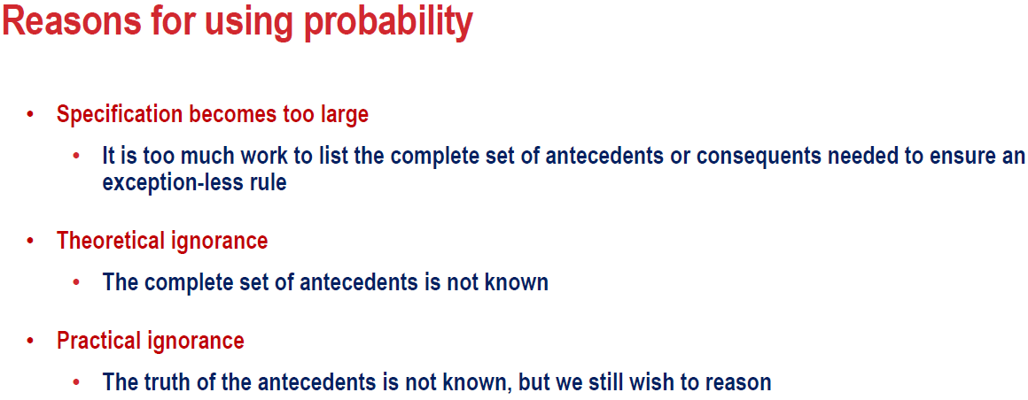

Slide 17
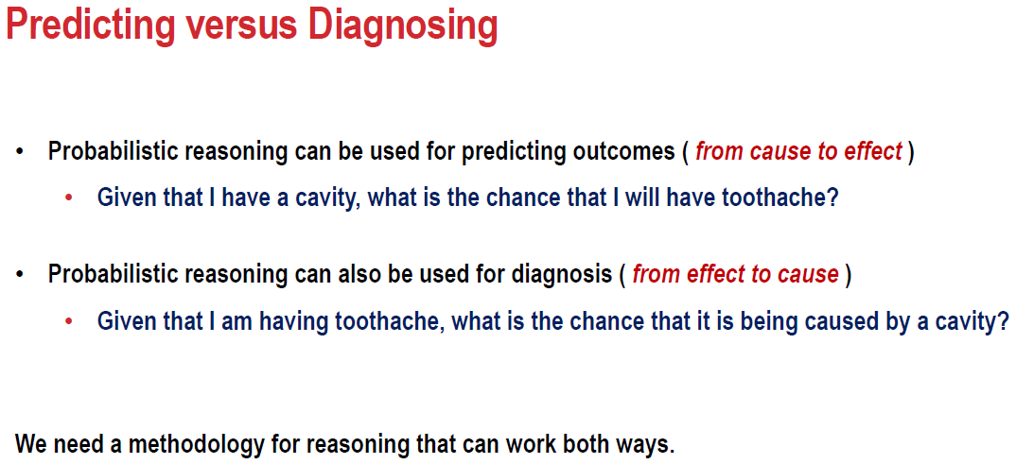

Slide 18
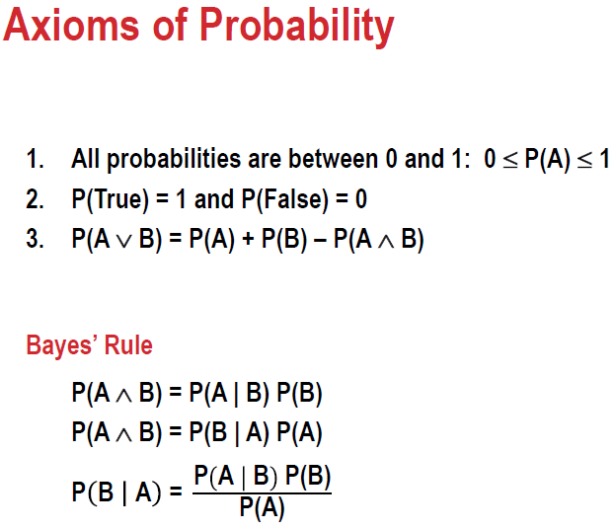

Slide 19
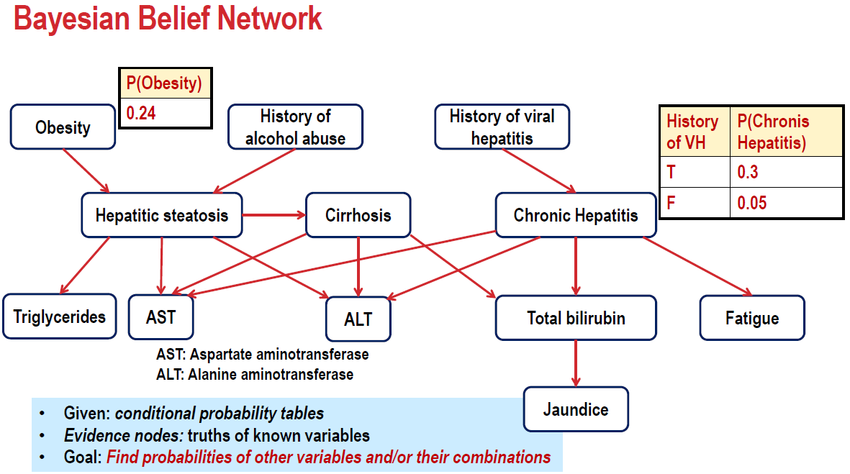

Slide 20
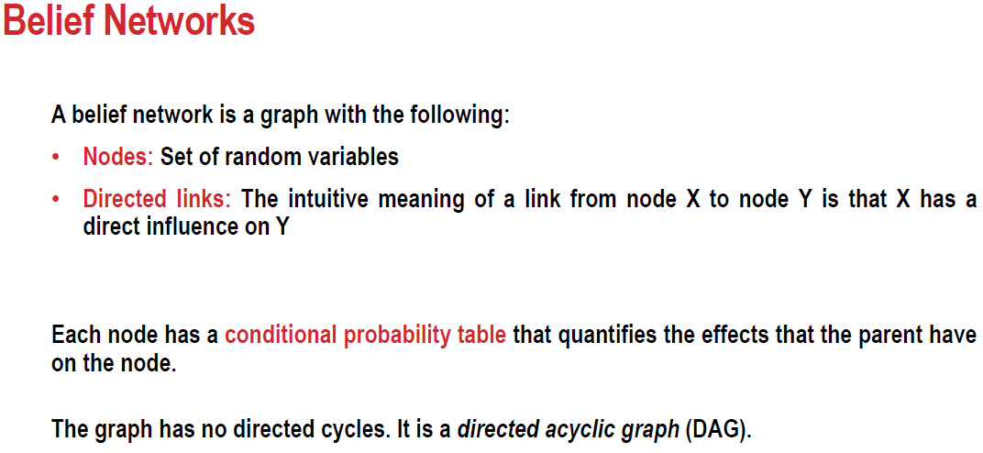

Slide 21
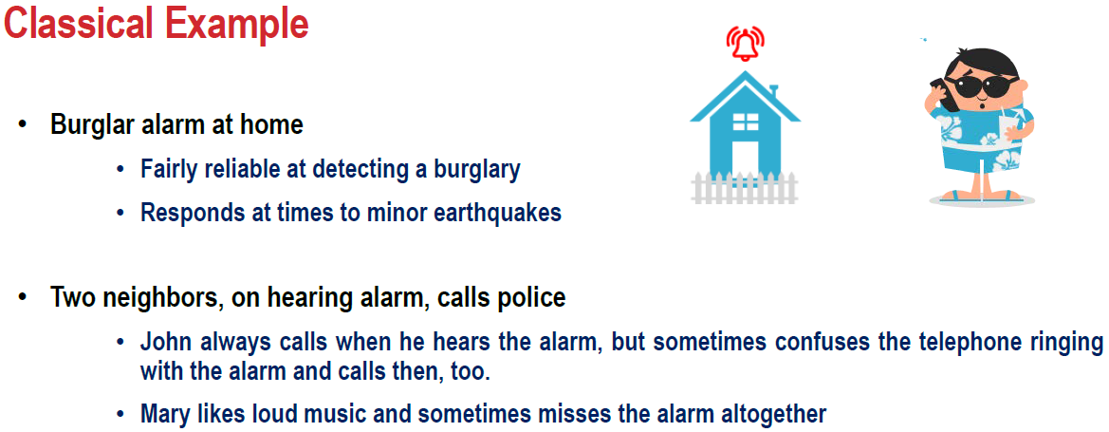

Slide 22
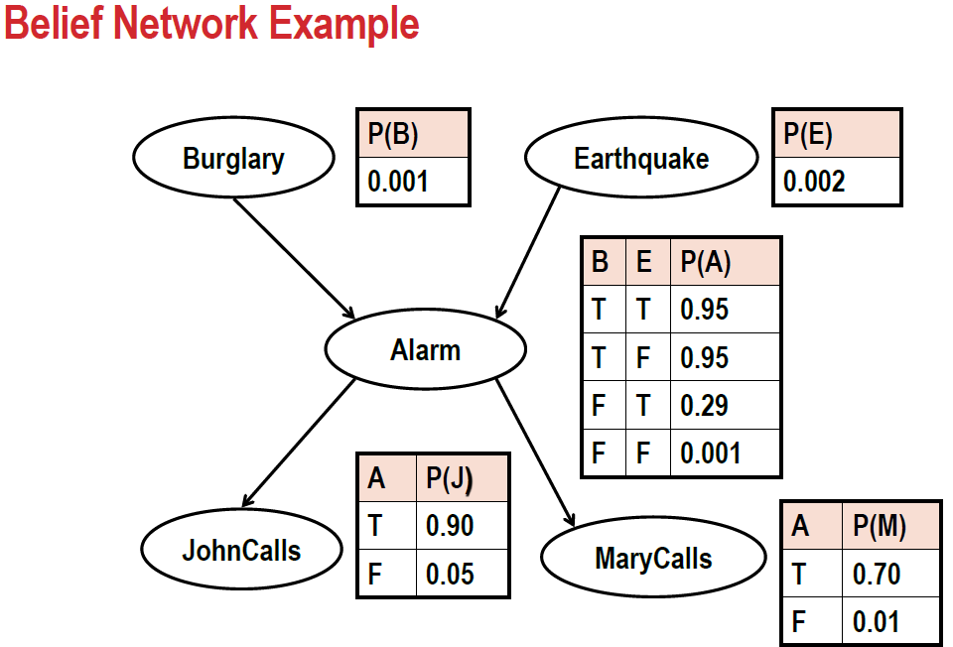

Slide 23
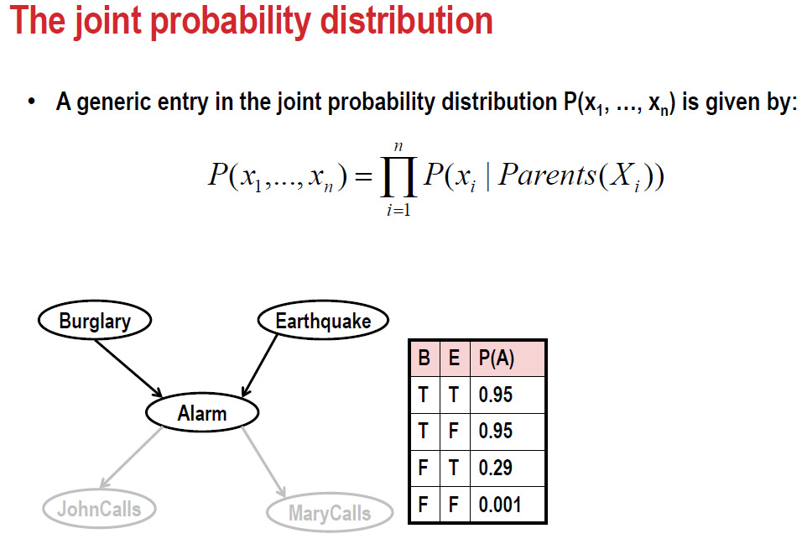

Slide 24
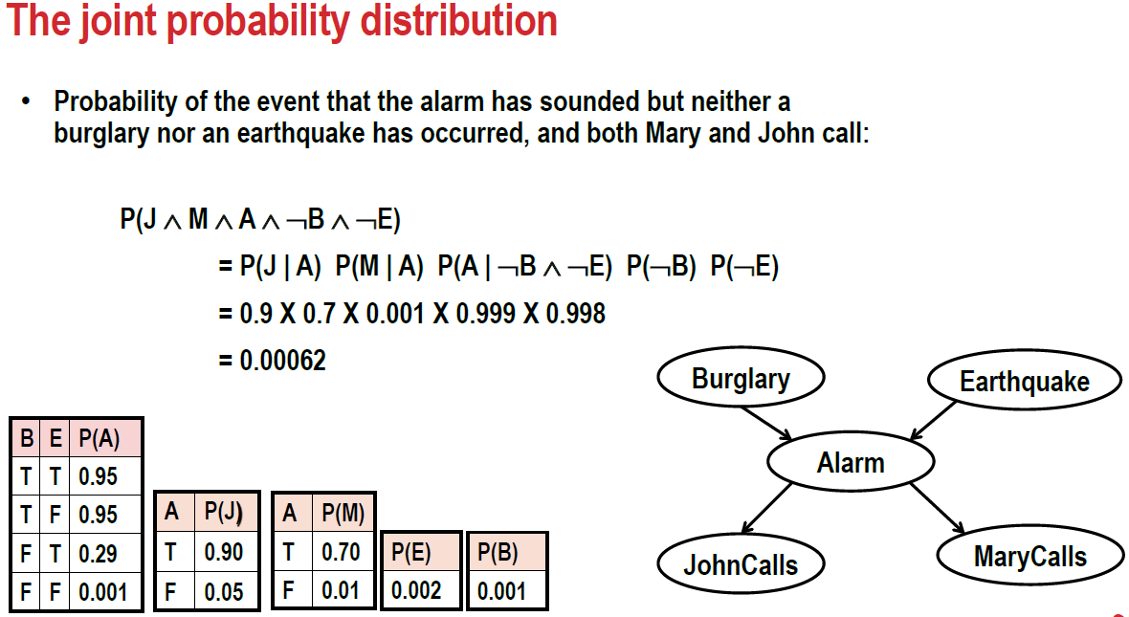

Slide 25
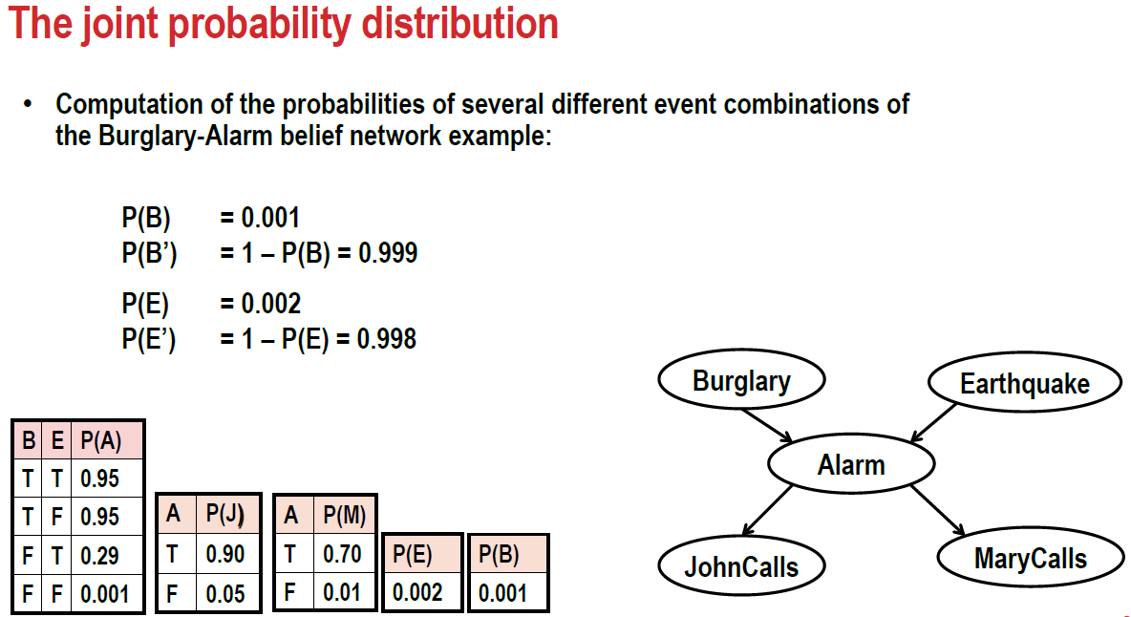

Slide 26
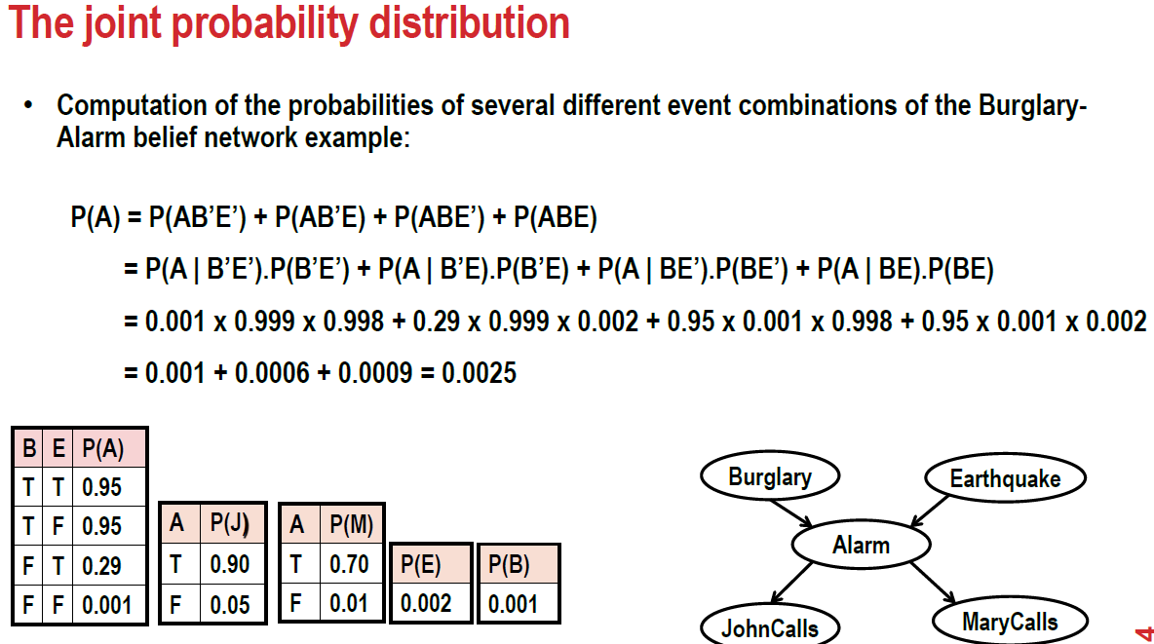

Slide 27
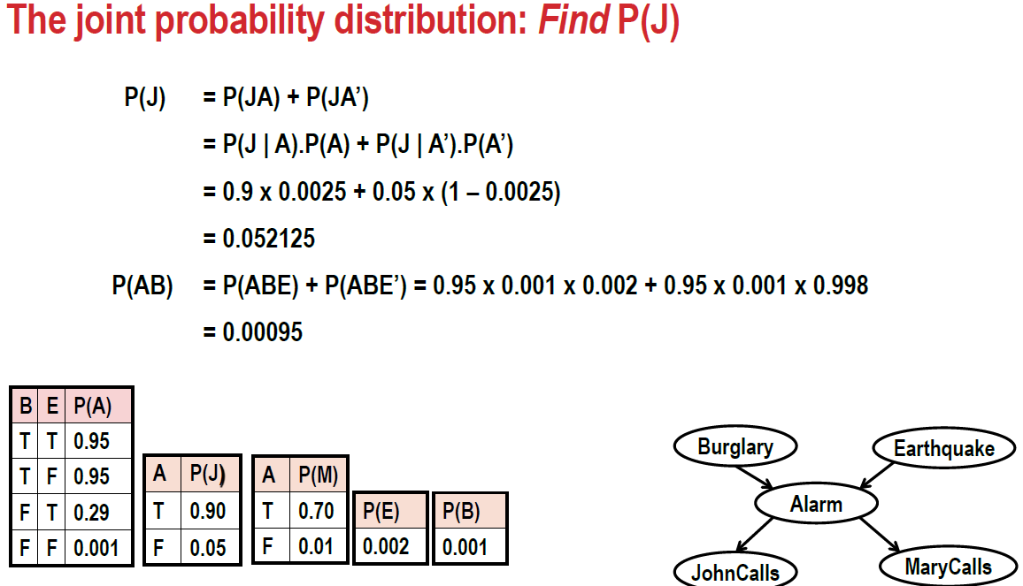

Slide 28
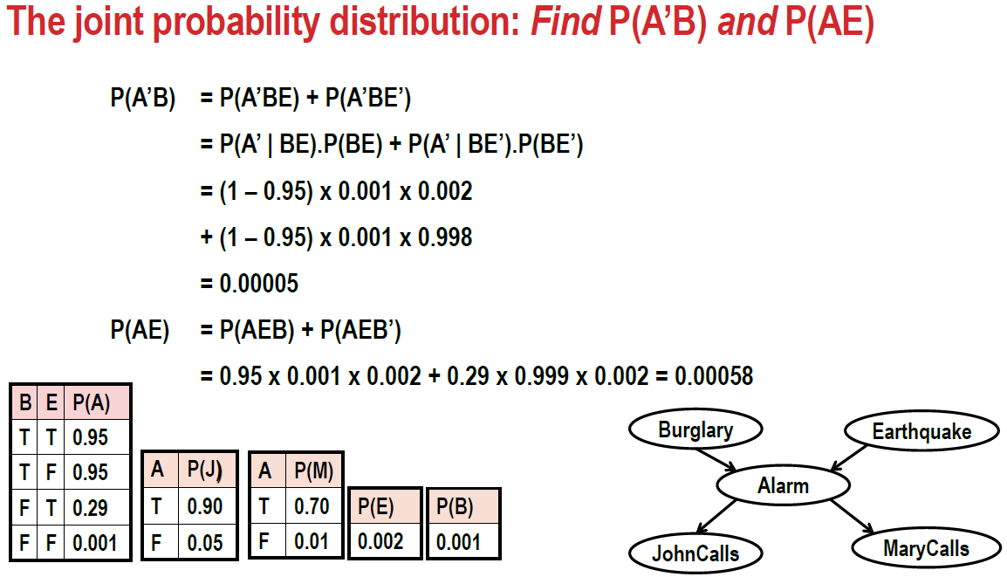

Slide 29
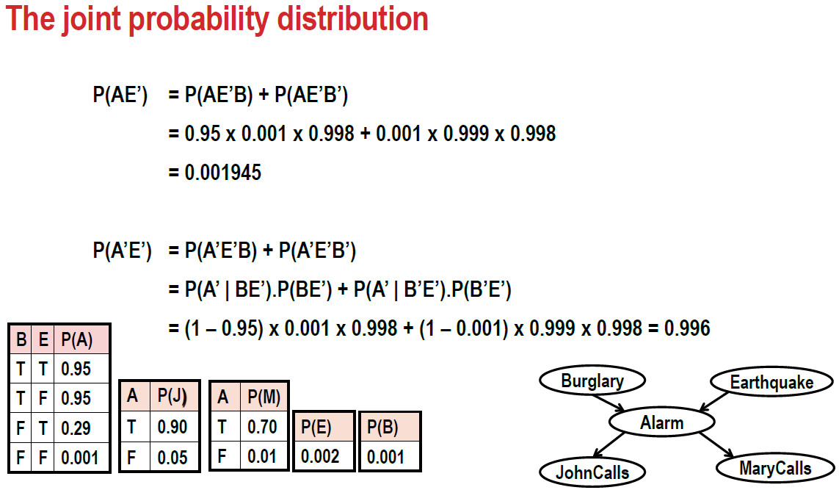

Slide 30
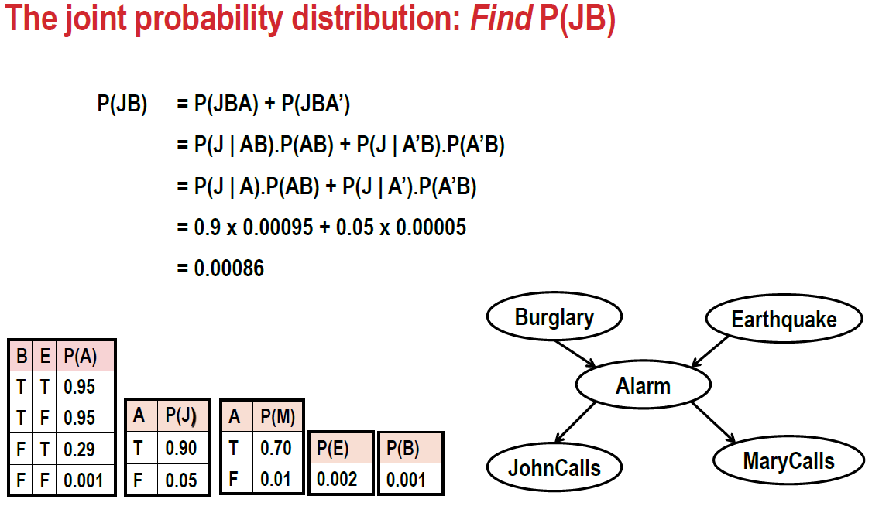

Slide 31
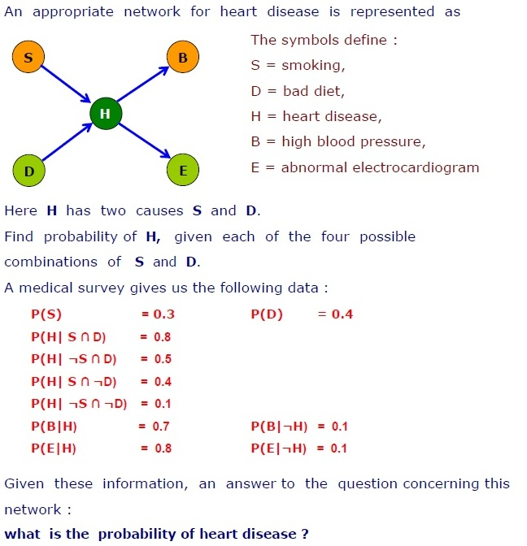

Slide 32
Let us now understand the mechanism of Bayesian Networks and their advantages with the help of a simple example. In this example, let us imagine that we are given the task of modeling a student’s marks (m) for an exam he has just given.
From the given Bayesian Network Graph below, we see that the marks depend upon two other variables. They are,
Exam Level (e)– This discrete variable denotes the difficulty of the exam and has two values (0 for easy and 1 for difficult)
IQ Level (i) – This represents the Intelligence Quotient level of the student and is also discrete in nature having two values (0 for low and 1 for high)
Additionally, the IQ level of the student also leads us to another variable, which is the Aptitude Score of the student (s). Now, with marks the student has scored, he can secure admission to a particular university. The probability distribution for getting admitted (a) to a university is also given below.

Slide 33
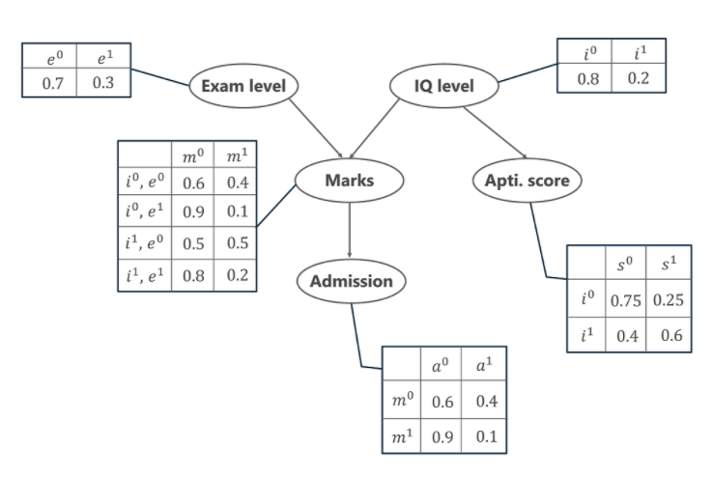

Slide 34
In the above graph, we see several tables representing the probability distribution values of the given 5 variables. These tables are called the Conditional Probabilities Table or CPT. There are a few properties of the CPT given below –
The sum of the CPT values in each row must be equal to 1 because all the possible cases for a particular variable are exhaustive (representing all possibilities).
If a variable that is Boolean in nature has k Boolean parents, then in the CPT it has 2K probability values.
Coming back to our problem, let us first list all the possible events that are occurring in the above-given table.
Exam Level (e)
IQ Level (i)
Aptitude Score (s)
Marks (m)
Admission (a)

Slide 35
These five variables are represented in the form of a Directed Acyclic Graph (DAG) in a Bayesian Network format with their Conditional Probability tables. Now, to calculate the Joint Probability Distribution of the 5 variables the formula is given by,
P[a, m, i, e, s]= P(a | m) . P(m | i, e) . P(i) . P(e) . P(s | i)
From the above formula,
P(a | m) denotes the conditional probability of the student getting admission based on the marks he has scored in the examination.
P(m | i, e) represents the marks that the student will score given his IQ level and difficulty of the Exam Level.
P(i) and P(e) represent the probability of the IQ Level and the Exam Level.
P(s | i) is the conditional probability of the student’s Aptitude Score, given his IQ Level.
With the following probabilities calculated, we can find the Joint Probability
Distribution of the entire Bayesian Network.

Slide 36
Case 1: Calculate the probability that in spite of the exam level being difficult, the student having a low IQ level and a low Aptitude Score, manages to pass the exam and secure admission to the university.

Slide 37
From the above word problem statement, the Joint Probability Distribution can be written as below,
P[a=1, m=1, i=0, e=1, s=0]
From the above Conditional Probability tables, the values for the given conditions are fed to the formula and is calculated as below.
P[a=1, m=1, i=0, e=0, s=0] = P(a=1 | m=1) . P(m=1 | i=0, e=1) . P(i=0) . P(e=1) . P(s=0 | i=0)
= 0.1 * 0.1 * 0.8 * 0.3 * 0.75
= 0.0018

Slide 38
Case 2: In another case, calculate the probability that the student has a High IQ level and Aptitude Score, the exam being easy yet fails to pass and does not secure admission to the university.

Slide 39
The formula for the JPD is given by
P[a=0, m=0, i=1, e=0, s=1]
Thus,
P[a=0, m=0, i=1, e=0, s=1]= P(a=0 | m=0) . P(m=0 | i=1, e=0) . P(i=1) . P(e=0) . P(s=1 | i=1)
= 0.6 * 0.5 * 0.2 * 0.7 * 0.6
= 0.0252
Hence, in this way, we can make use of Bayesian Networks and Probability tables to calculate the probability for various possible events that occur.

Slide 40
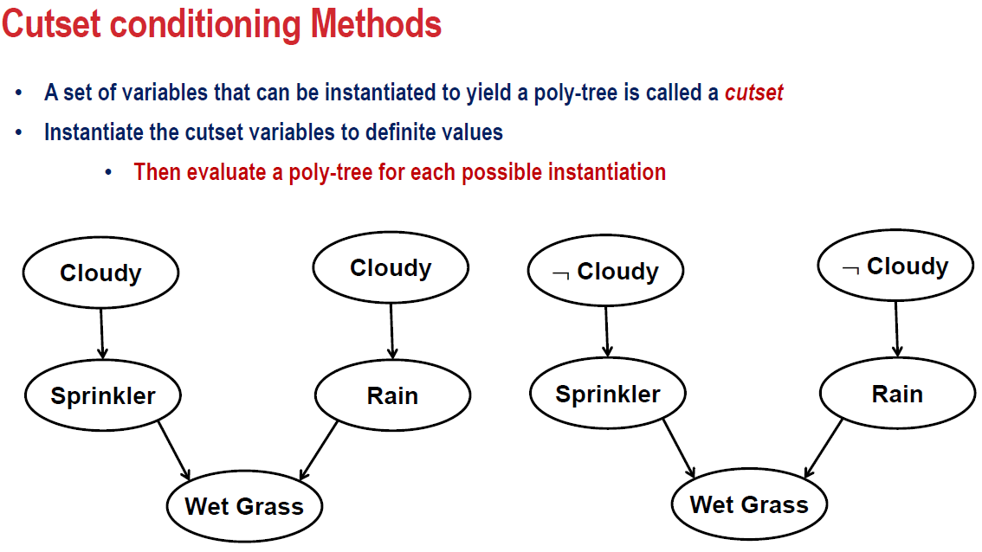

Slide 41
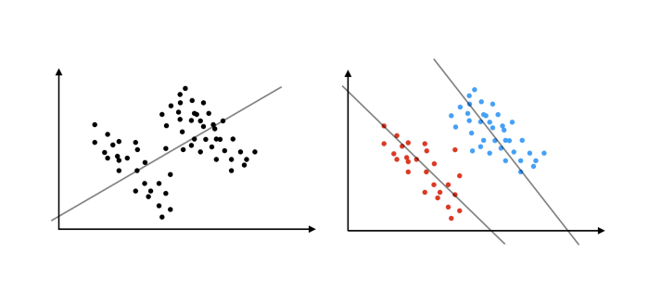
Simpson’s Paradox:
A trend or result that is present when data is put into groups that reverses or disappears when the data is combined.

Slide 42
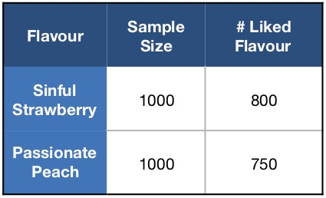
Strawberry vs Peach
Suppose we’re in the soft drinks industry and we’re trying to choose between two new flavours we’ve produced. We could sample public opinion on the two flavours — let’s say we choose to do so by setting up two sampling stalls for each flavour in a busy area and asking 1000 people at each stall if they enjoy the new flavour.
Inference:
We can see that 80% of people enjoyed ‘Sinful Strawberry’ whereas only 75% of people enjoyed ‘Passionate Peach’. So ‘Sinful Strawberry’ is more likely to be the preferred flavour.

Slide 43
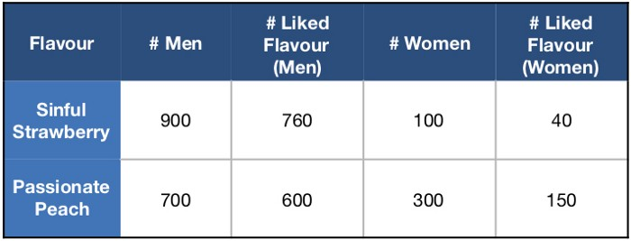
Now, suppose our marketing team collected some other information while conducting the survey, such as the sex of the person sampling the drink. What happens if we split our data up by sex?
This suggests that 84.4% of men and 40% of women liked ‘Sinful Strawberry’ whereas 85.7% of men and 50% of women liked ‘Passionate Peach’. If we stop to think, this might seem a little strange: according to our sample data, generally people prefer ‘Sinful Strawberry’, but both men and women separately prefer ‘Passionate Peach’. This is an example of Simpson’s Paradox!

Slide 44
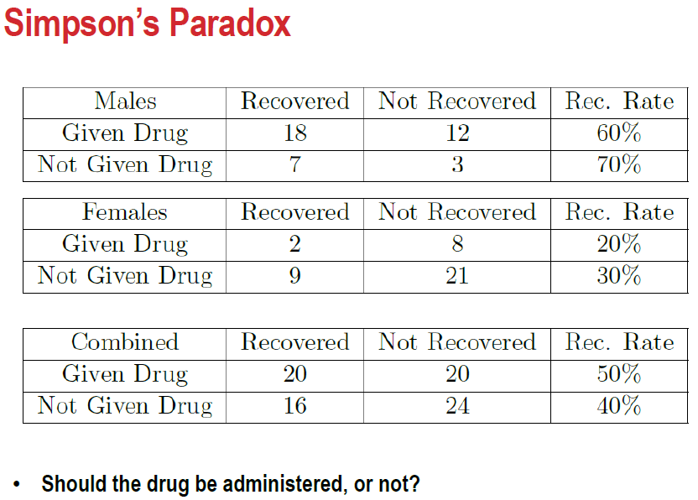

Slide 45
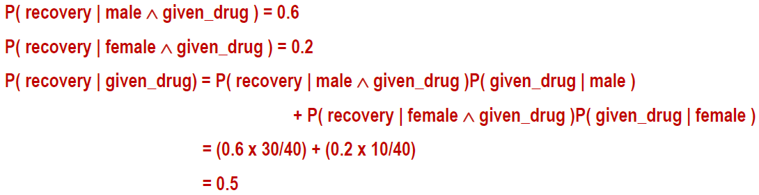

Slide 46
Lurking variables
Simpson’s paradox arises when there are hidden variables that split data into multiple separate distributions. Such a hidden variable is aptly referred to as a lurking variable, and they can often be difficult to identify. Luckily, this is not the case in our soft drink example, and our marketing team should quickly be able to see that the sex of the person sampling the new flavours is affecting their opinion.
One way the paradox can be explained is by considering the lurking variable (sex) and a little bit of probability theory:
P(Liked Strawberry) = P(Liked Strawberry | Man)P(Man) + P(Liked Strawberry | Woman)P(Woman)
800/1000 = (760/900)×(900/1000) + (40/100)×(100/1000)
P(Liked Peach) = P(Liked Peach | Man)P(Man) + P(Liked Peach | Woman)P(Woman)
750/1000 = (600/700)×(700/1000) + (150/300)×(300/1000)

Slide 47
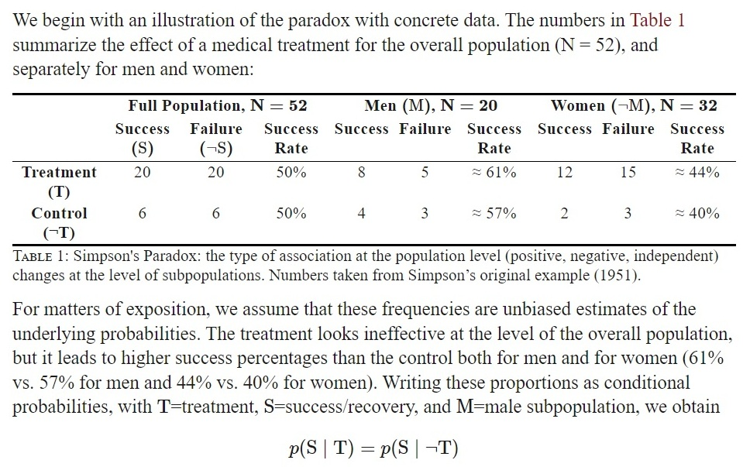

Slide 48
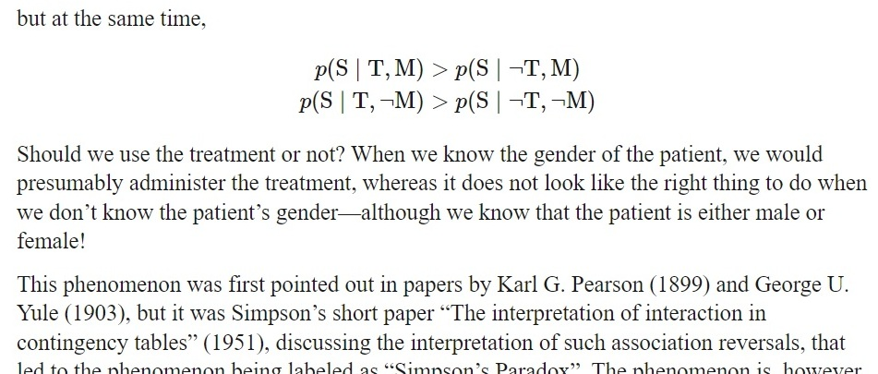

Slide 49
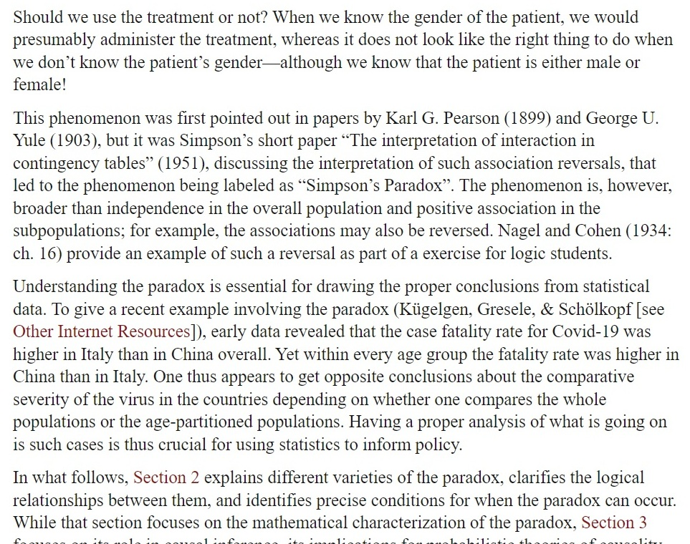

Slide 50
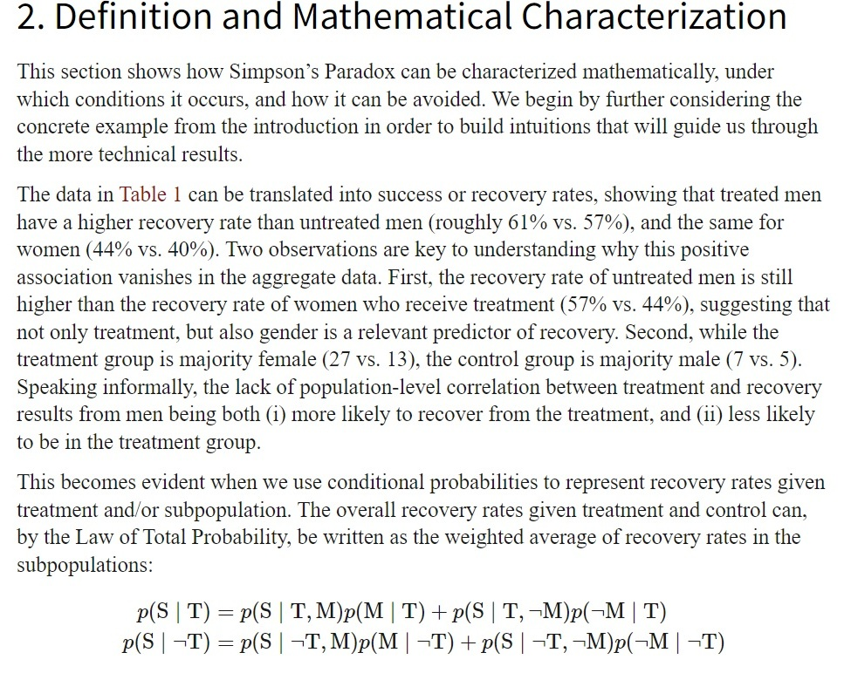

Slide 51
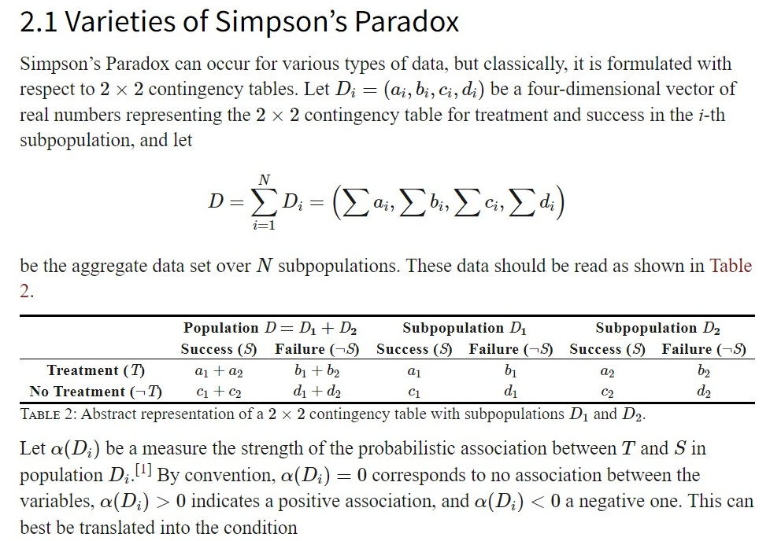

Slide 52
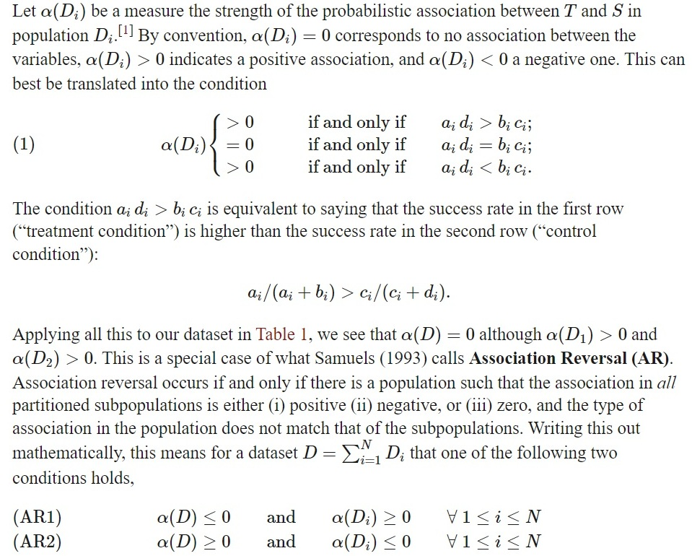

Slide 53
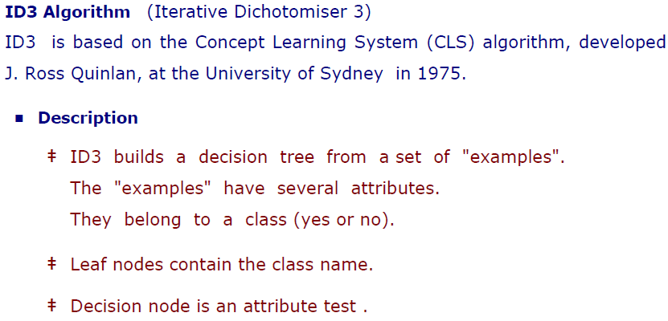

Slide 54
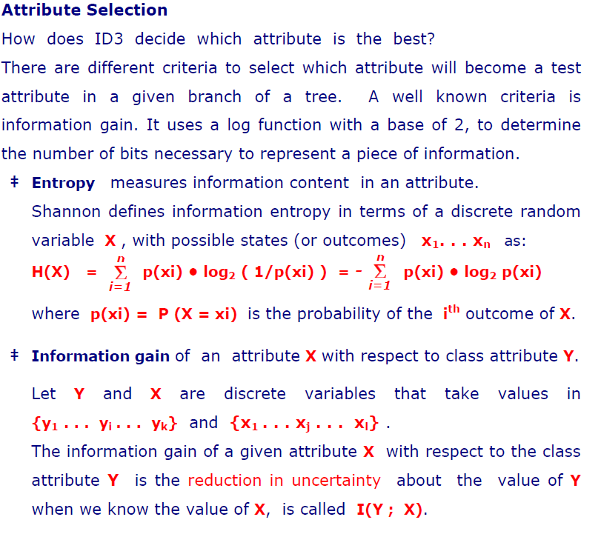

Slide 55
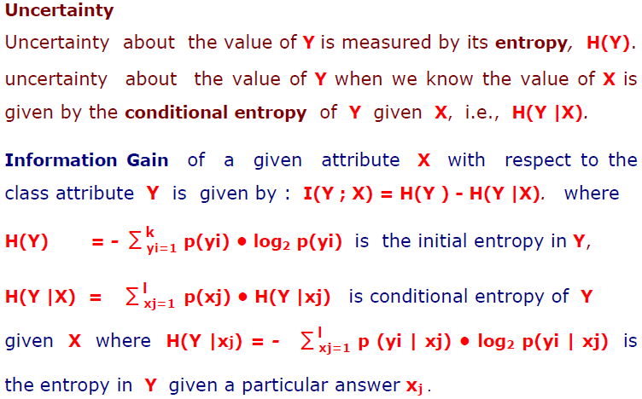

Slide 56
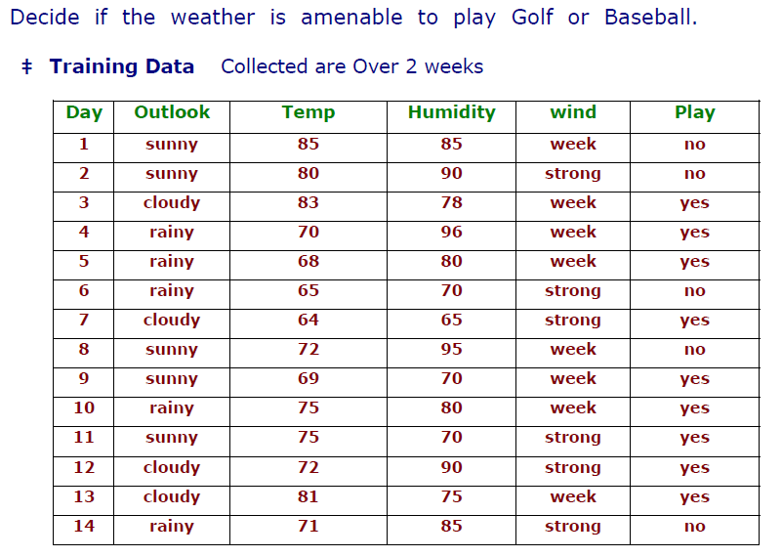

Slide 57
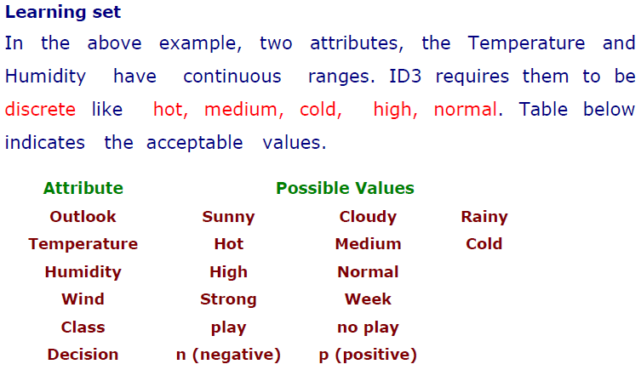

Slide 58
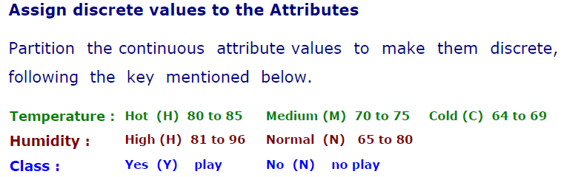

Slide 59
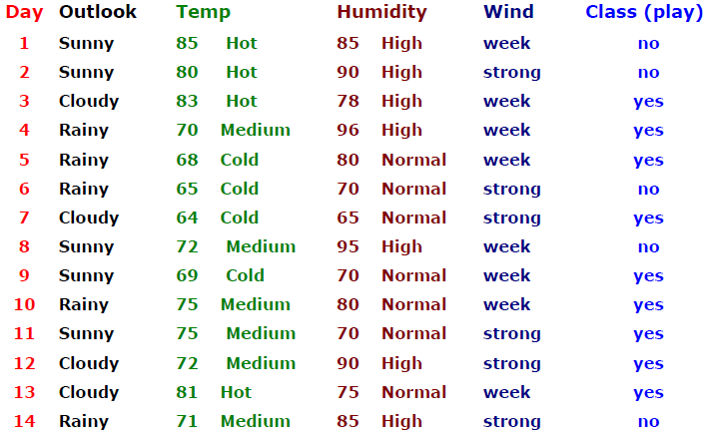

Slide 60


Slide 61


Slide 62


Slide 63


Slide 64


Slide 65


Slide 66


Slide 67


Slide 68


Slide 69


Slide 70


Slide 71


Slide 72


Slide 73


Slide 74


Slide 75


Slide 76


Slide 77


Slide 78


Slide 79


Slide 80


Slide 81


Slide 82


Slide 83


Slide 84


Slide 85


Slide 86


Slide 87


Slide 88


Slide 89


Slide 90


